Slide 1
A Survey of Deep Learning and Foundation Models for Time Series Forecasting
Speaker: Ching (Jason) Chang
Supervisor: Wen-Chih (Chris) Peng

Slide 2
Outline
Introduction
What is time-series data?
What is time-series forecasting?
Methods
Statistical and Machine Learning Models
Deep Learning Models
Transformers
Graph Neural Networks (GNNs)
Foundation Models
Evaluation
Metrics
Datasets

Slide 3
Introduction

Slide 4
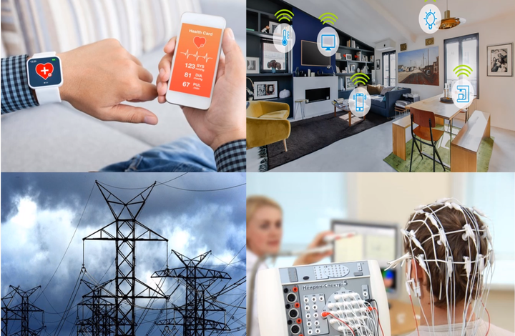
The Ubiquity of Time-Series
https://cruiseresearchgroup.github.io/project/time-series_forecasting_and_segmentation/

Slide 5
Tabular Data ≠ Time Series Data
features
features
x1
x2
x3
y
f1
f2
f3
data window
data window
time

Slide 6
Group POV (case 1)
Irregular Time-Series Data
We also care about the ordering
S1
S2
S3
S4
S5
S6
S7
S1
S2
wafer id | f1 (M) | S1_f1 (M) | S2_f2 (M) | S3_f1 (Q) | S3_f2 (M) | … | S7_f1 (Q)
W1 | PART1 | RCP1 | 7.3 | XXX | 23 | … | 22
W2 | PART1 | RCP1 | 1.6 | XXX | 45 | … | 31
W3 | PART1 | RCP1 | 0.4 | XXX | 30 | … | 13
W4 | PART2 | RCP2 | 0.2 | XXX | 14 | … | 24
W5 | PART2 | RCP2 | 0.9 | XXX | 36 | … | 34
… | … | … | … | … | … | … | …
W97 | PART3 | RCP1 | 3.7 | XXX | 30 | … | 23
W98 | PART3 | RCP2 | 1.6 | XXX | 45 | … | 67
W99 | PART3 | RCP2 | 0.5 | XXX | 64 | … | 83
W100 | PART3 | RCP2 | 3.5 | XXX | 12 | … | 80
S3
S4
S5
S6
S7
causal graph

Slide 7
Individual POV (case 2)
Tabular Data
We treat each wafer individually
S1
S2
S3
S4
S5
S6
S7
S1
S2
wafer id | f1 (M) | S1_f1 (M) | S2_f2 (M) | S3_f1 (Q) | S3_f2 (M) | … | S7_f1 (Q)
W1 | PART1 | RCP1 | 7.3 | XXX | 23 | … | 22
W2 | PART1 | RCP1 | 1.6 | XXX | 45 | … | 31
W3 | PART1 | RCP1 | 0.4 | XXX | 30 | … | 13
W4 | PART2 | RCP2 | 0.2 | XXX | 14 | … | 24
W5 | PART2 | RCP2 | 0.9 | XXX | 36 | … | 34
… | … | … | … | … | … | … | …
W97 | PART3 | RCP1 | 3.7 | XXX | 30 | … | 23
W98 | PART3 | RCP2 | 1.6 | XXX | 45 | … | 67
W99 | PART3 | RCP2 | 0.5 | XXX | 64 | … | 83
W100 | PART3 | RCP2 | 3.5 | XXX | 12 | … | 80
S3
S4
S5
S6
S7
causal graph

Slide 8
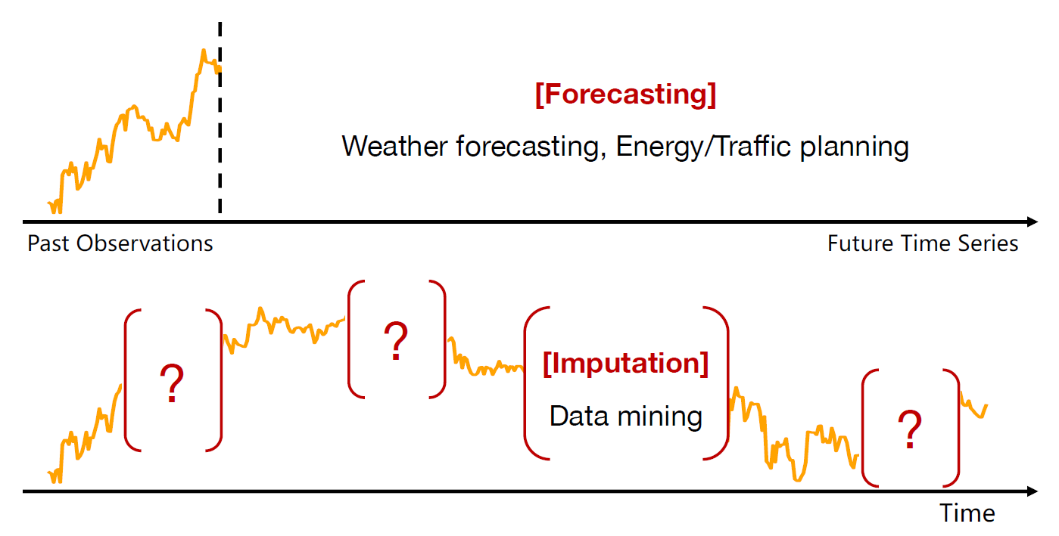
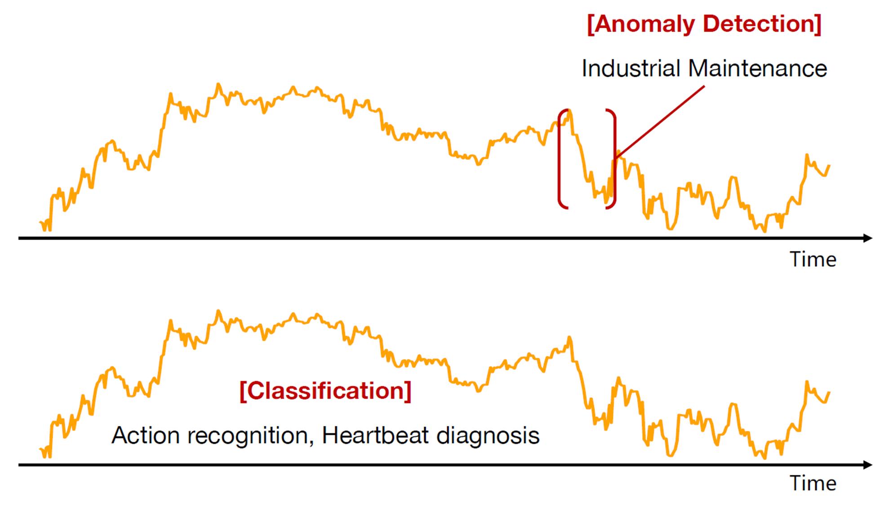
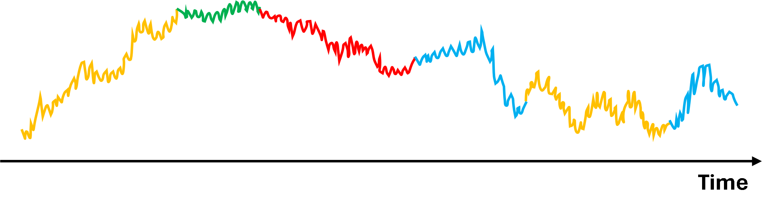
Time-Series Tasks
Forecasting
Long-term Forecasting
Short-term Forecasting
Imputation
Anomaly Detection
Classification
Segmentation
[Segmentation]
https://wuhaixu2016.github.io/pdf/ICLR2023_TimesNet.pdf

Slide 9
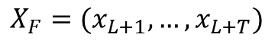
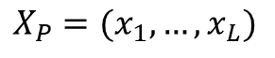
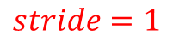
Problem Formulation for Forecasting
$$stride=1$$
past
future
$$X_{P}=(x_{1},…,x_{L})$$
$$X_{F}=(x_{L+1},…,x_{L+T})$$
forecast

Slide 10
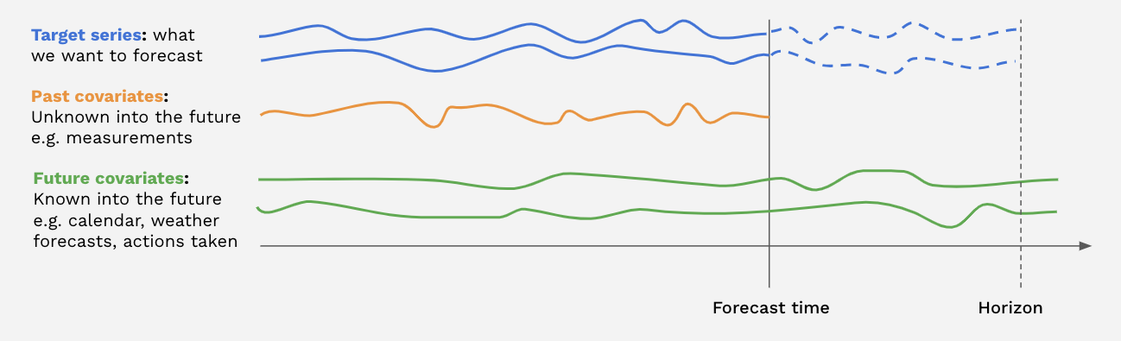
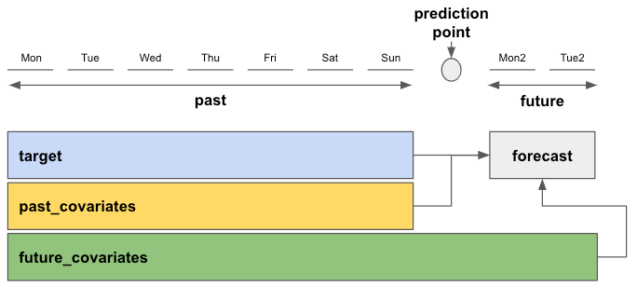
What are covariates?

Slide 11
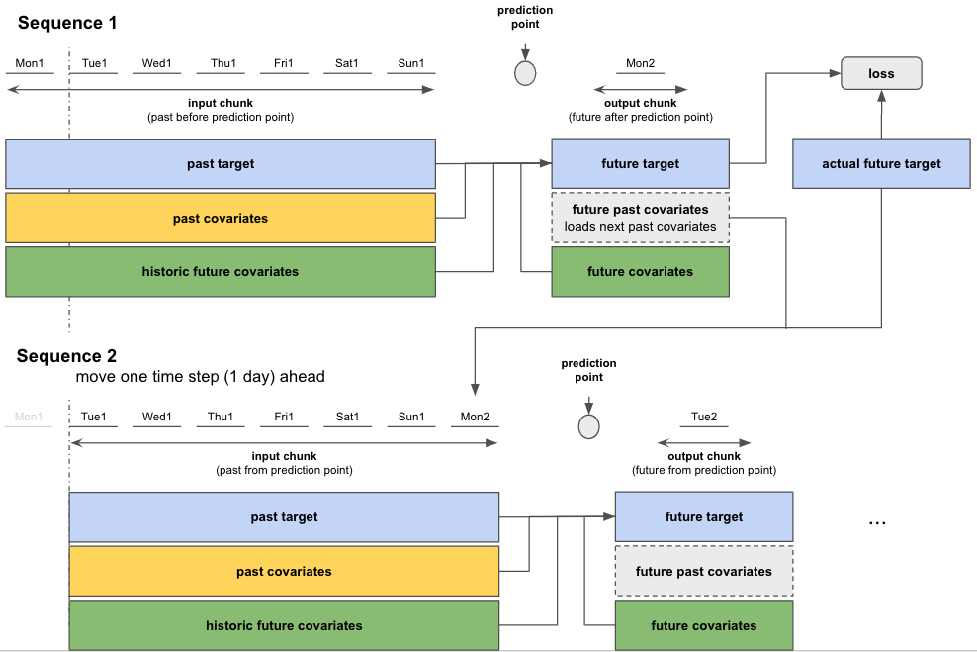

Slide 12
Methods

Slide 13
Type 1: Statistical and Machine Learning Models
Statistical Models
ARIMA
Machine Learning Models
Decision Tree
Boosting Tree
XGBoost
LightGBM
CatBoost
Linear Regression
… (any regressor in scikit-learn)

Slide 14
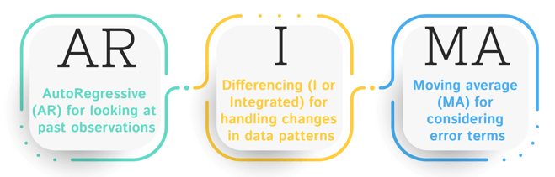
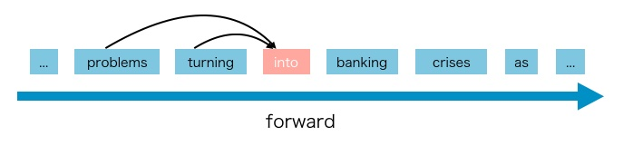
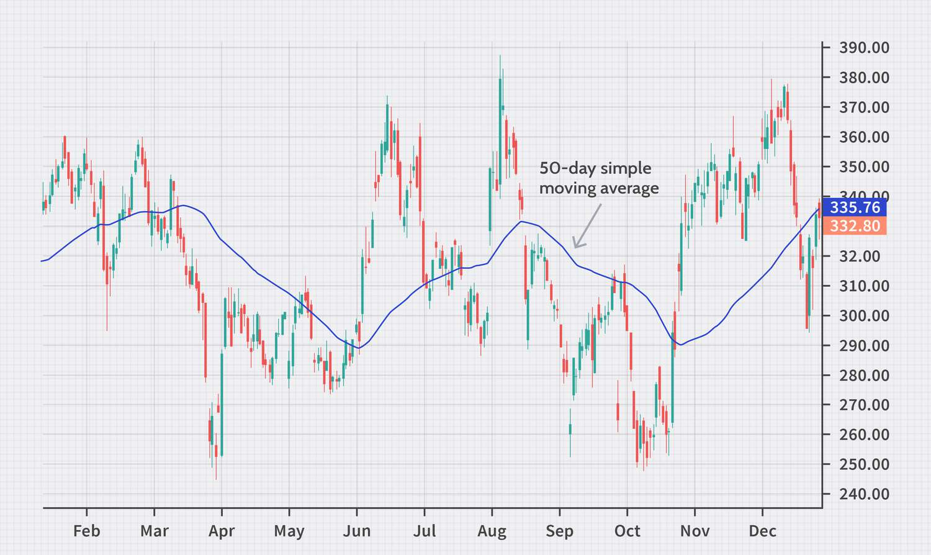
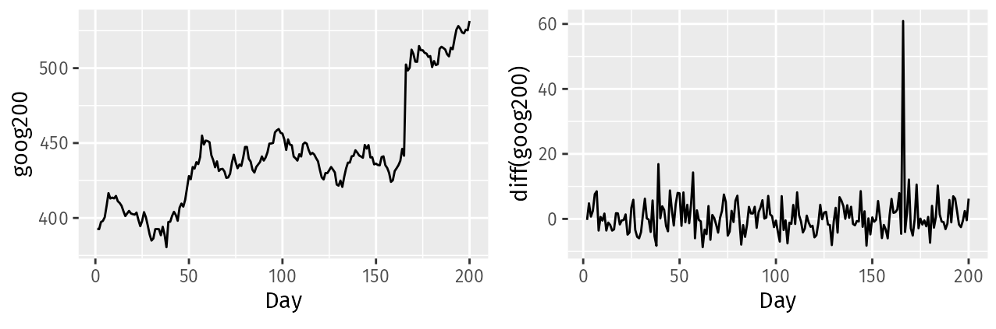
ARIMA

Slide 15
Type 2: Deep Learning Models
LSTM/GRU
CNN
TCN-based
TCN, TimesNet
N-BEATS, N-HiTS
Linear-based
DLinear/NLinear, RLinear
MLP-based
TSMixer
TiDE
TimeMixer

Slide 16
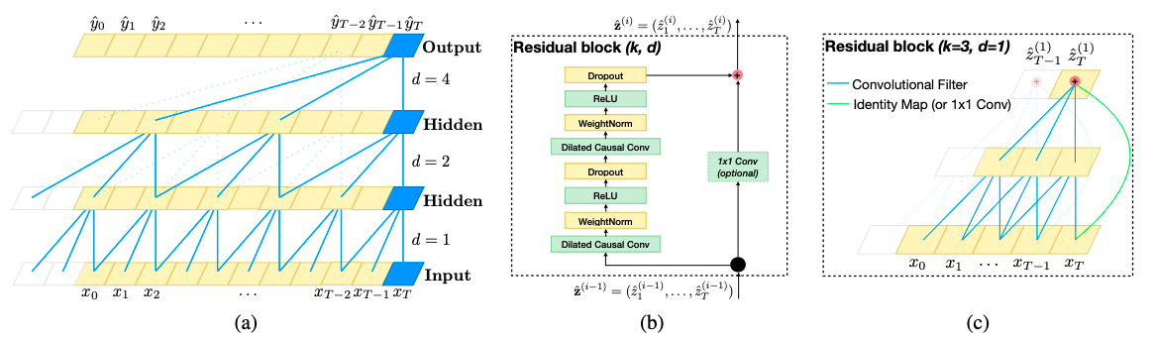
TCN
A TCN, short for Temporal Convolutional Network, consists of dilated, causal 1D convolutional layers with the same input and output lengths.

Slide 17
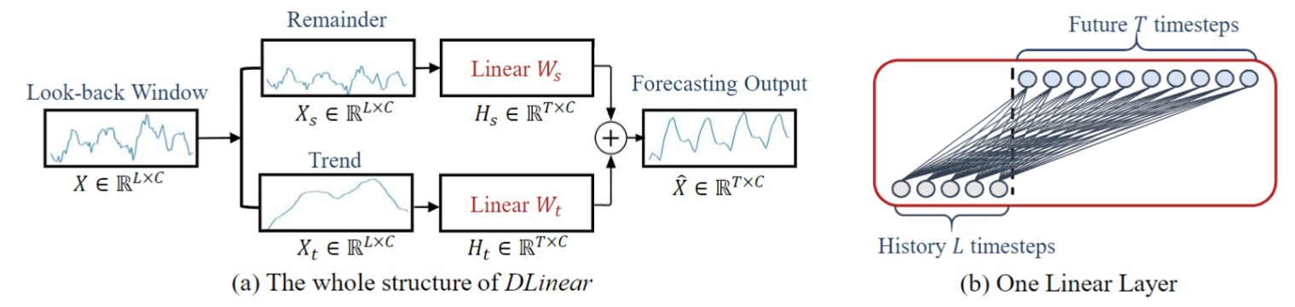
DLinear/NLinear
AAAI 2023
Dlinear
NLinear
NLinear first subtracts the input by the last value of the sequence.
Then, the input goes through a linear layer.
Finally, the subtracted part is added back before making the final prediction.

Slide 18
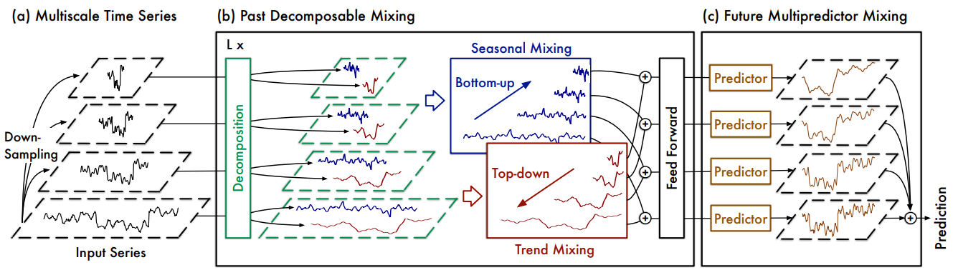
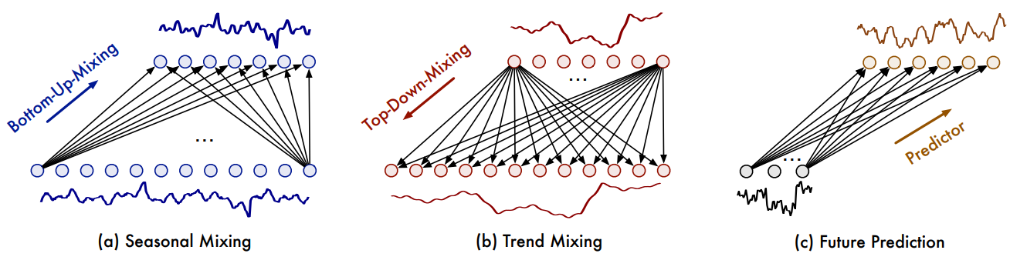
TimeMixer
ICLR 2024

Slide 19
Type 3: Transformers
Informer
Autoformer
FEDformer
Crossformer
…
PatchTST
iTransformer

Slide 20
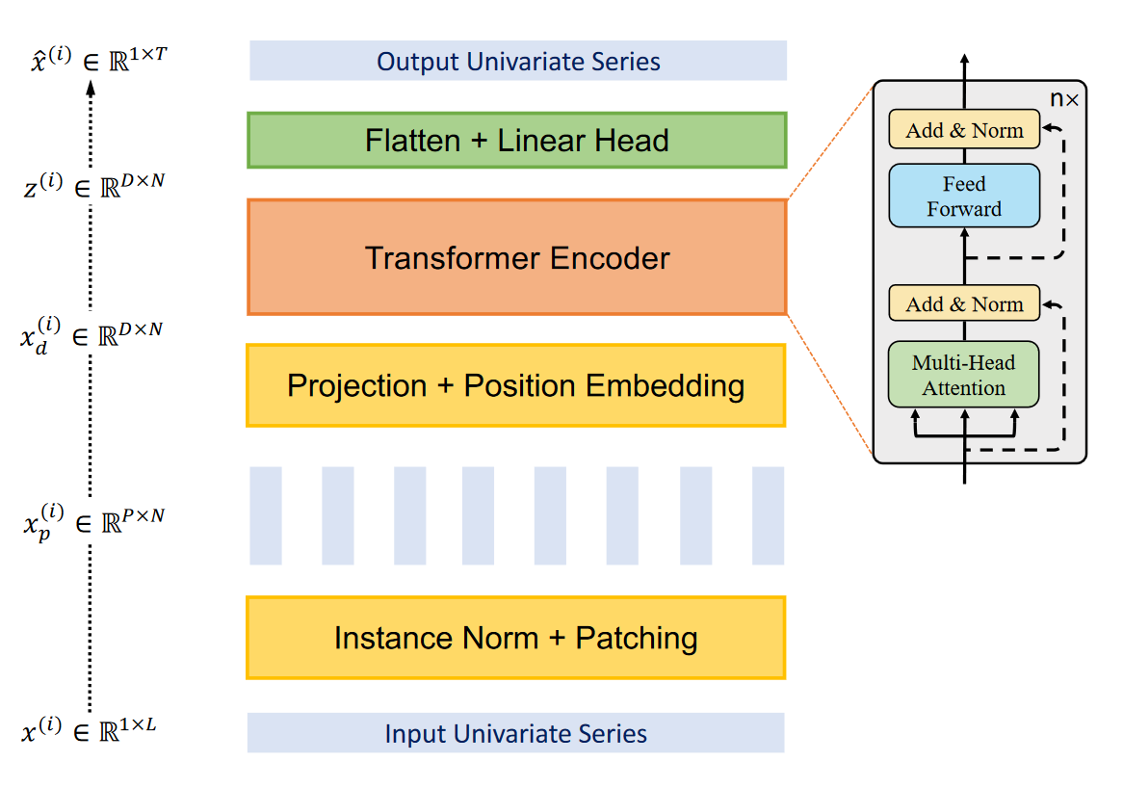
PatchTST
ICLR 2023
2. RevIN
3. Patching
1. Channel-Independence

Slide 21
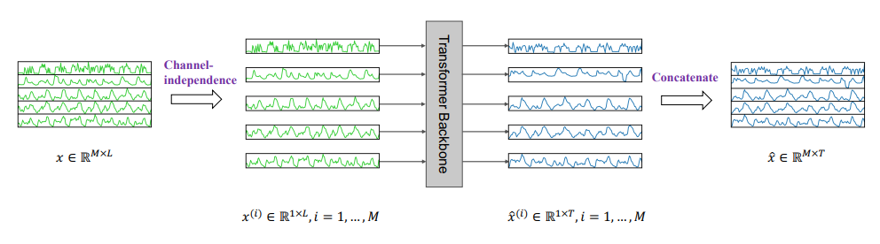
PatchTST – 1. Channel-Independence

Slide 22
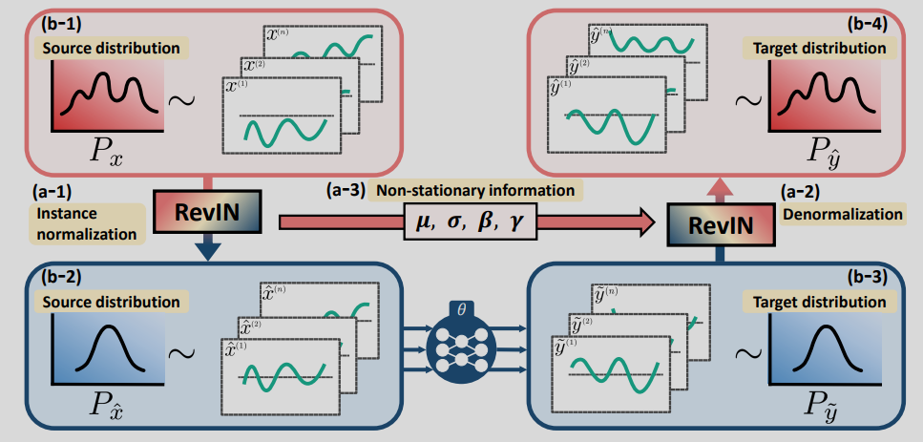
PatchTST – 2. RevIN
RevIN = IN in the input layer, and reverse it in the output layer
ICLR 2022
Input layer
Output layer

Slide 23
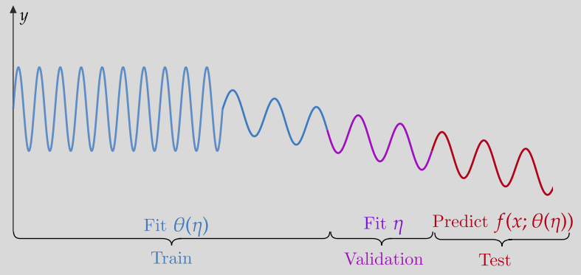
Why do we need RevIN?
Statistical properties such as mean and variance often change over time in time series, i.e., time-series data suffer from a distribution shift problem.

Slide 24
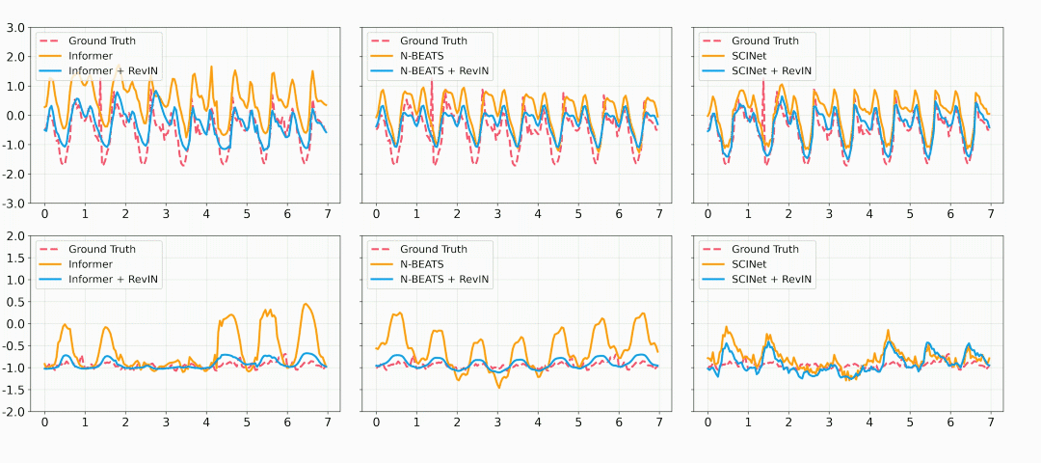
What’s the experimental results on their paper?

Slide 25
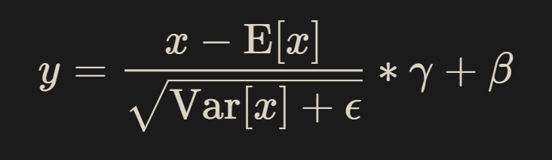
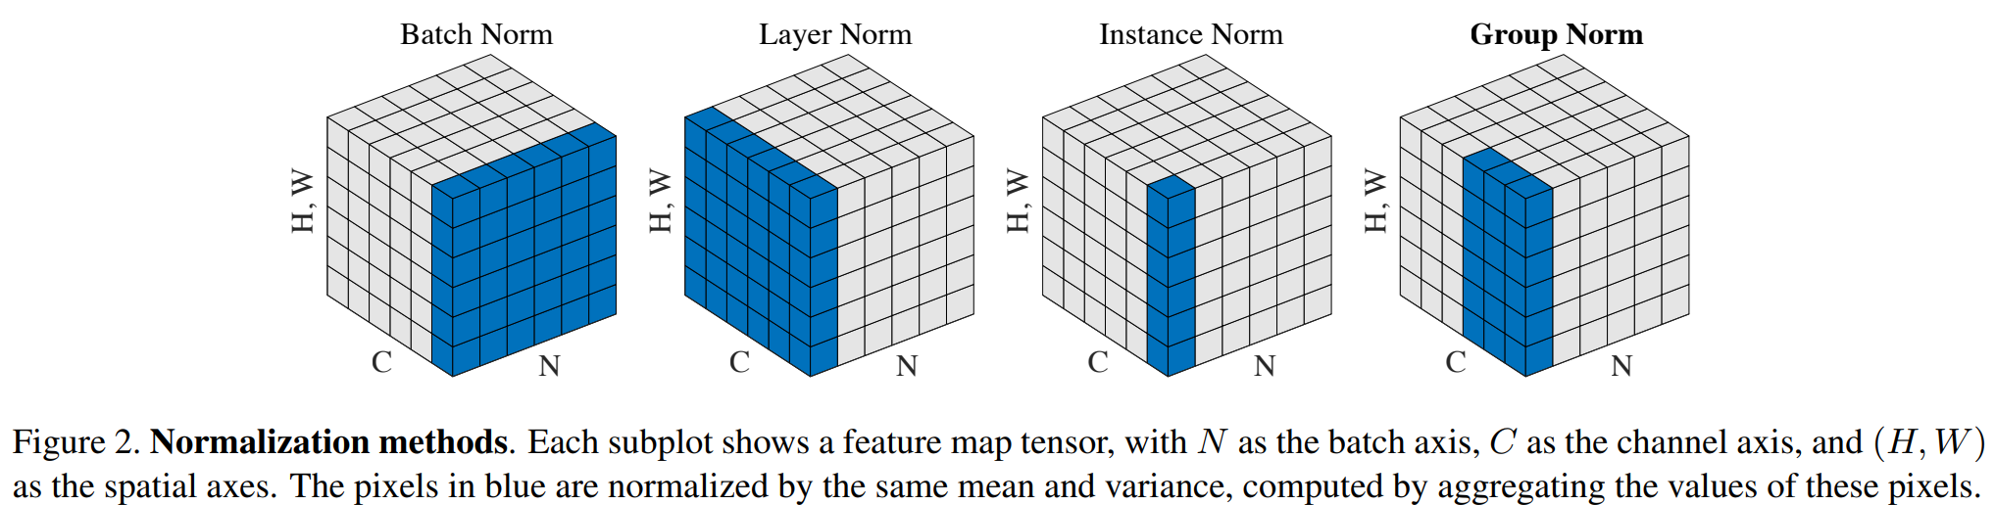
Normalization Layers
Affine
shift → scale → re-scale → re-shift
learnable

Slide 26
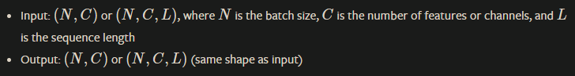
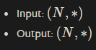
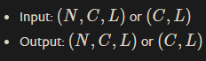
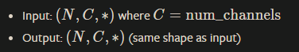
Normalization Layers
nn.BatchNorm1d
nn.LayerNorm
nn.InstanceNorm1d
nn.GroupNorm
(B, C, T) → (B, C, T)
BN
(B, C, T) → (B, C, T)
LN
(B, C, T) → (B, C, T)
IN
(B, C, T) → (B, C, T)
GN

Slide 27
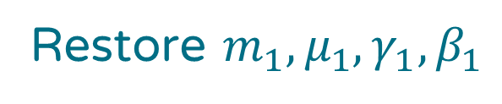
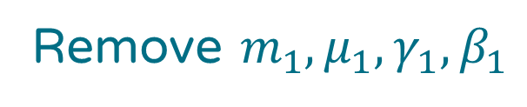
RevIN in details
We still apply z-score normalization on our dataset.
Remove $m_{1},μ_{1},γ_{1},β_{1}$
Hidden layer
Restore $m_{1},μ_{1},γ_{1},β_{1}$
Input layer
Output layer
…
1
2
3
1’
2’
3’
…
1
2
3
1’
2’
3’
…
1
2
3
1’
2’
3’
…
(B, C, T) → (B, C, T)
RevIN_{remove}
(B, C, T) → (B, C, T)
RevIN_{restore}
We apply normalization on each (instance, channel)

Slide 28





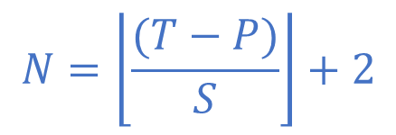



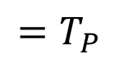
PatchTST – 3. Patching
3.
(B, C, T_{P}, P)
(w/ Channel Independence)
B’
…
$$T$$
…
$$C$$
$$N$$
$$=T_{P}$$
2.
$$N$$
…
…
$$P$$
$$S$$
$$P$$
4.
Encoding (token + pos)
Linear/
Conv1D
1.
It won’t be larger than $S$
$$N=\left\lfloor \frac{(T−P)}{S}\right\rfloor +2$$
…
Linear on T
$$D$$
(B, C, T_{P}, D)
B’

Slide 29
Patching w/ multivariate
3.
(B, C, T_{P}, P)
(w/ Channel Independence)
B’
…
$$T$$
…
$$C$$
$$N$$
$$=T_{P}$$
2.
$$N$$
…
…
$$P$$
$$S$$
$$P$$
4.
Encoding (token + pos)
Linear/
Conv1D
1.
It won’t be larger than $S$
$$N=\left\lfloor \frac{(T−P)}{S}\right\rfloor +2$$
…
Linear on T
$$D$$
(B, C, T_{P}, D)
B’

Slide 30
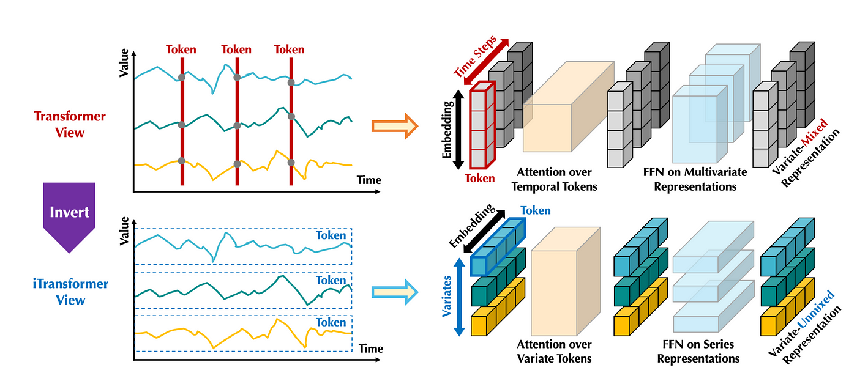
iTransformer
ICLR 2024

Slide 31
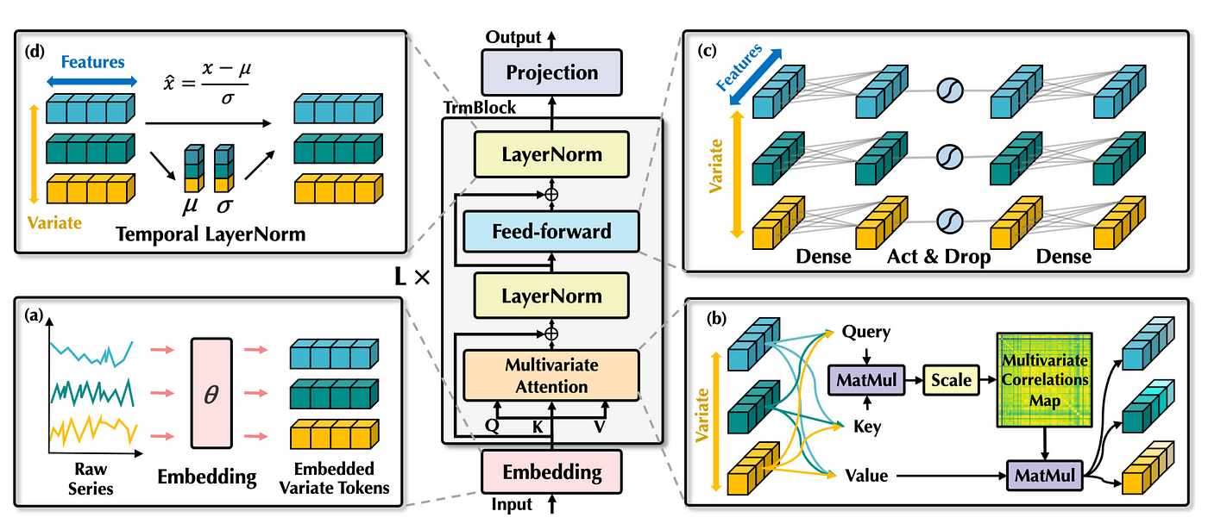
iTransformer
ICLR 2024

Slide 32
Graph Neural Networks (GNNs)
GCN
GAT
GIN
TGN

Slide 33
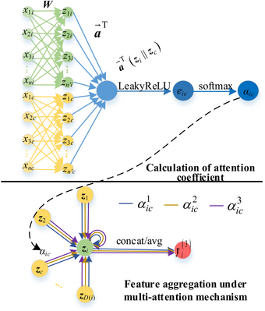
GAT
ICLR 2018

Slide 34
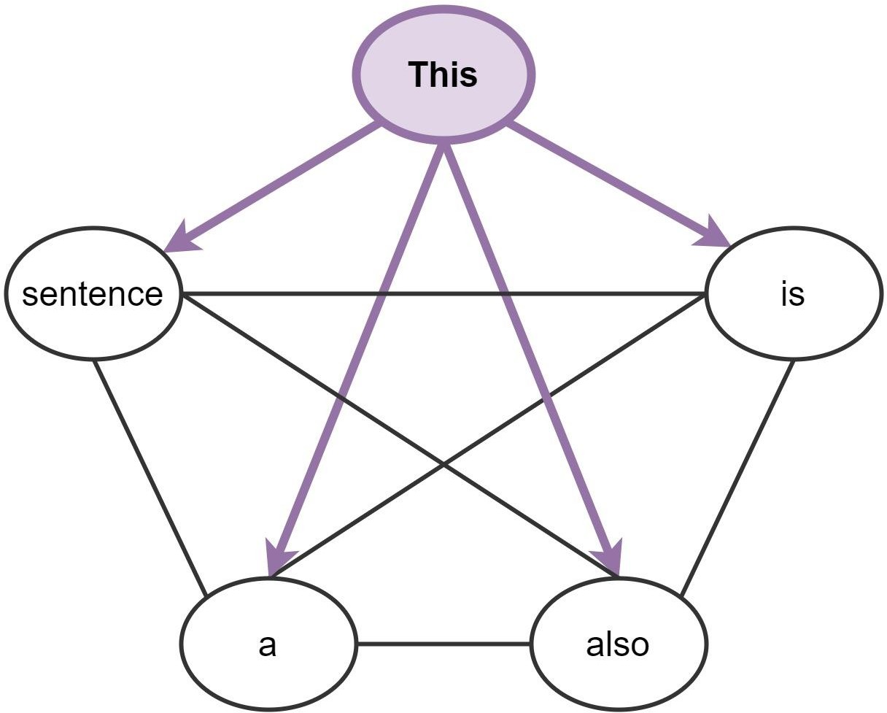
Connections b/w GNNs and Transformers
Consider a sentence as a fully
connected graph of words…
This is also a sentence

Slide 35
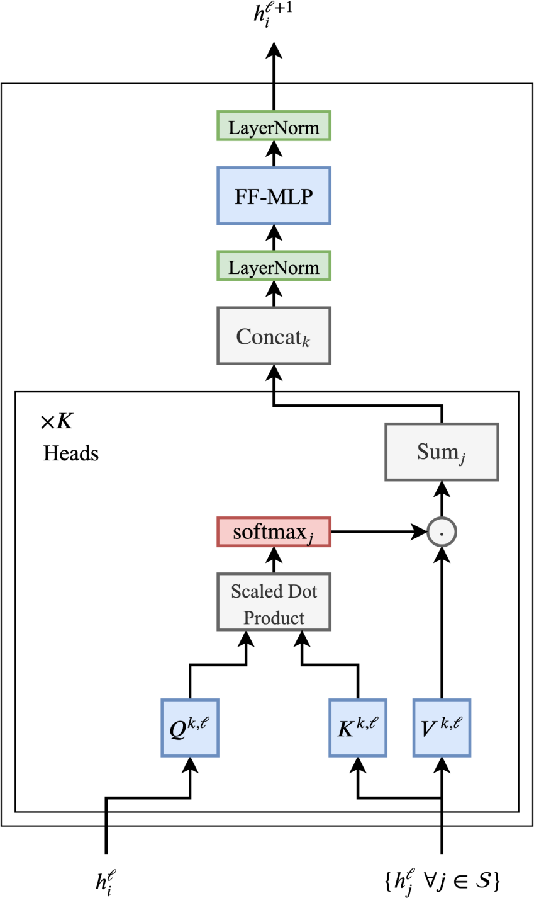
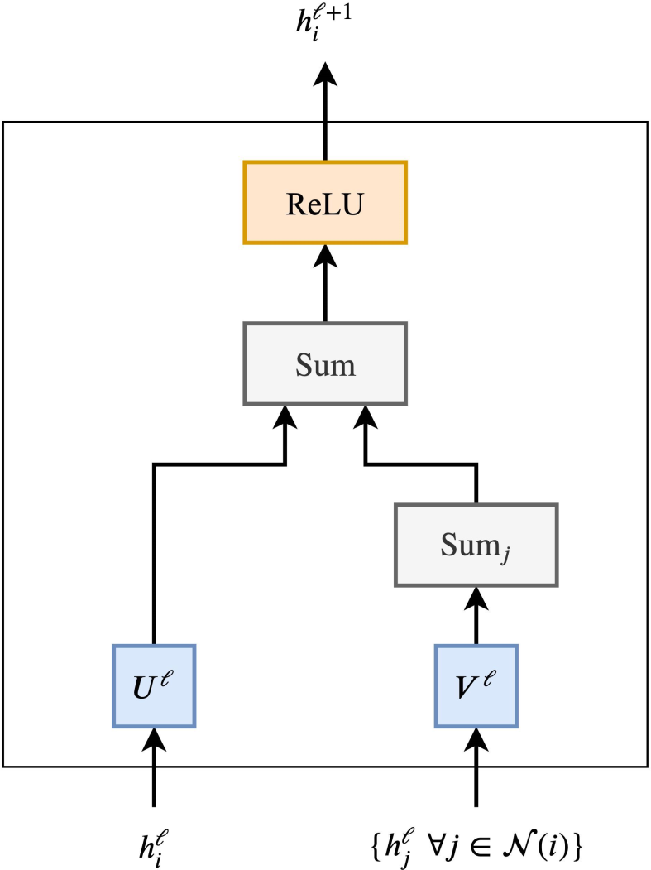
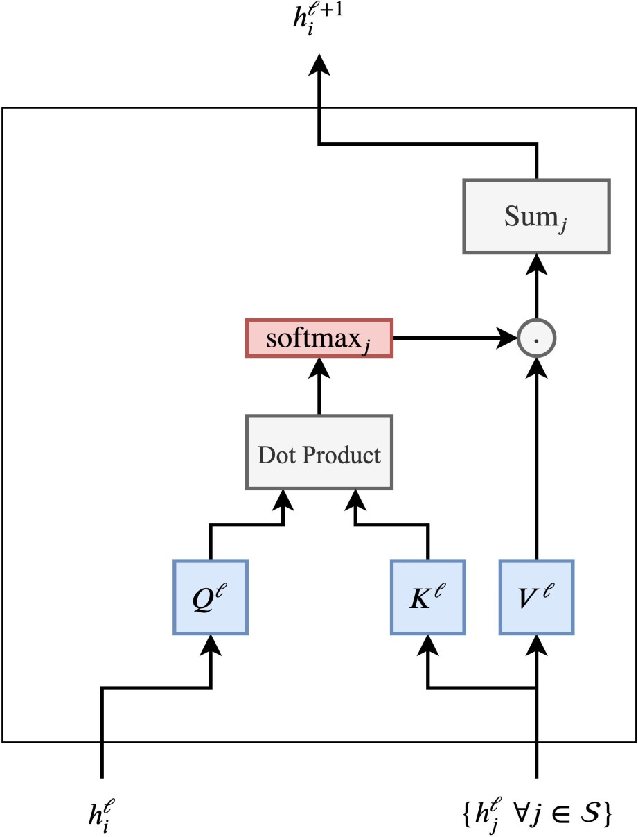
Transformer
GNN
Self-attention
+ Weighted sum aggregation
+ Multi-head mechanism
+ Normalization layers
+ Residual links

Slide 36
Type 5: Foundation Models
Repurposed LLMs
GPT4TS, LLM4TS, TEMPO
Broadly Pre-trained on Time-Series Datasets
TimeGPT, TimesFM, Lag-Llama
Pre-trained on Domain-related Time-Series Datasets
AutoMixer
Multimodal with Text and Time-Series
Time-LLM, UniTime

Slide 37
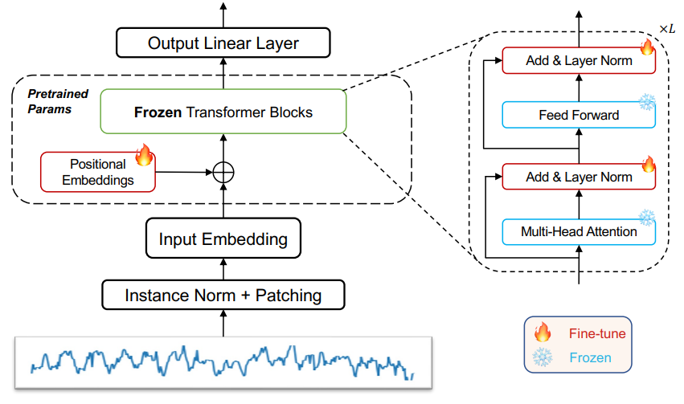
GPT4TS = PatchTST + FPT(GPT-2)
NeurIPS 2023

Slide 38
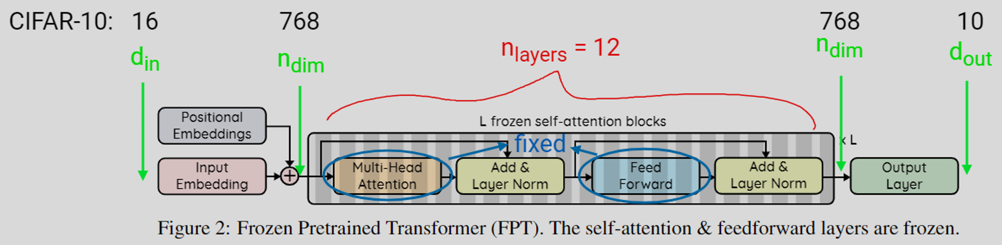
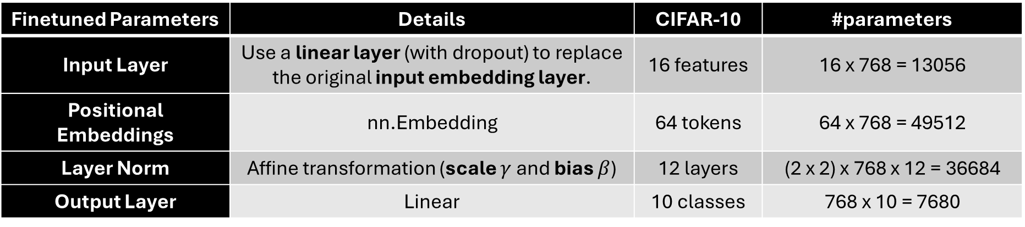
Frozen Pretrained Transformer (FPT)
For the base CIFAR-10 model with 124M parameters, these come out to approximately 0.086% of the network.
Finetuned Parameters | Details | CIFAR-10 | #parameters
Input Layer | Use a linear layer (with dropout) to replace the original input embedding layer. | 16 features | 16 x 768 = 13056
Positional Embeddings | nn.Embedding | 64 tokens | 64 x 768 = 49512
Layer Norm | Affine transformation (scale $γ$ and bias $β$) | 12 layers | (2 x 2) x 768 x 12 = 36684
Output Layer | Linear | 10 classes | 768 x 10 = 7680

Slide 39
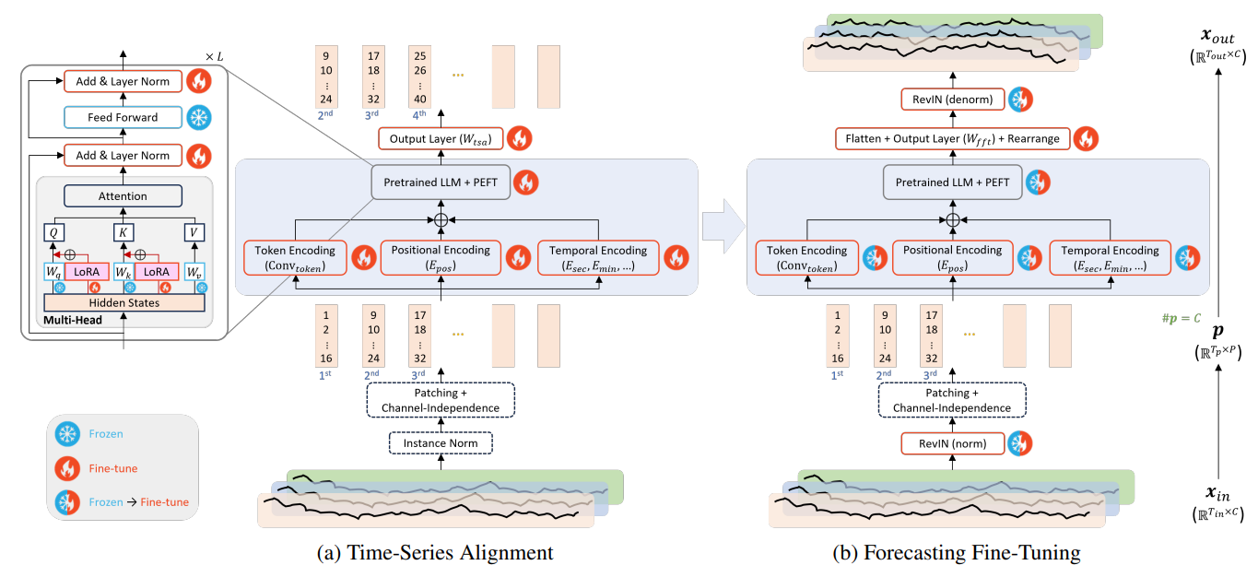
LLM4TS
TIST 2024 (under review)

Slide 40
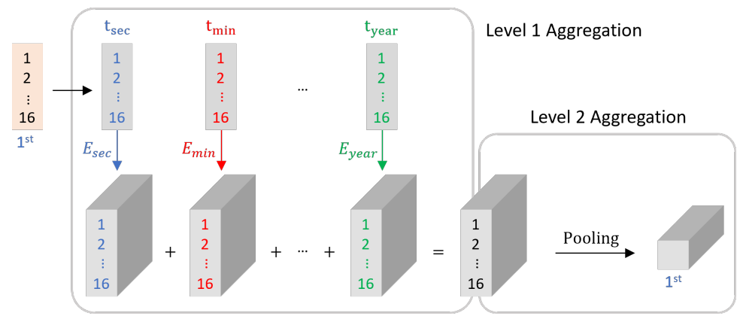
LLM4TS – Leveraging Temporal Embeddings with Patching

Slide 41
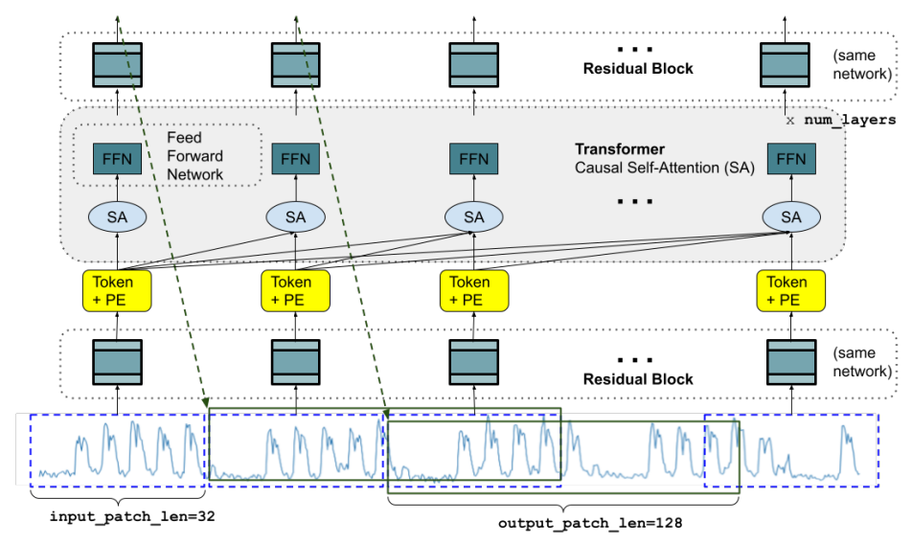
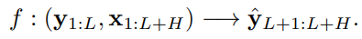
TimesFM
ICML 2024
Decoder only
Masked/Causal self-attention
AutoRegressive objective
Longer length for the output patches
Leverage time-based features as “future covariates”

Slide 42
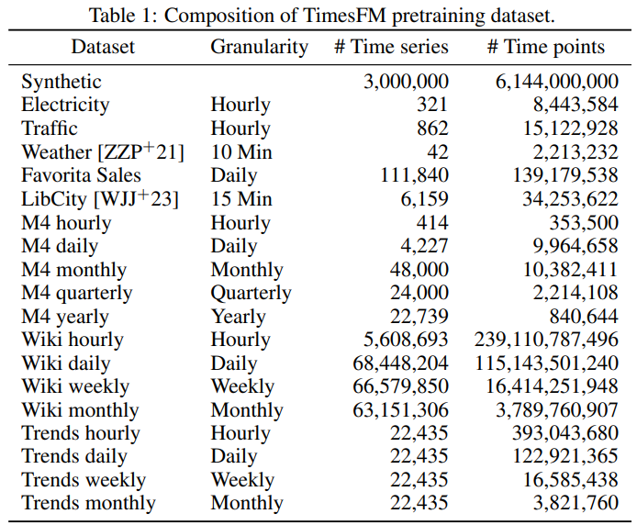
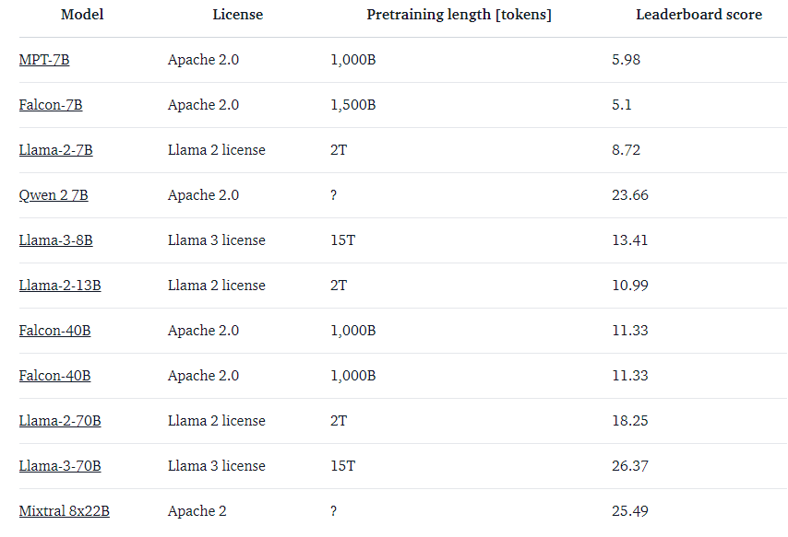
Pretraining Datatset
Model size: 200M parameters
Pretraining length: 100B timepoints
Open LLM:

Slide 43
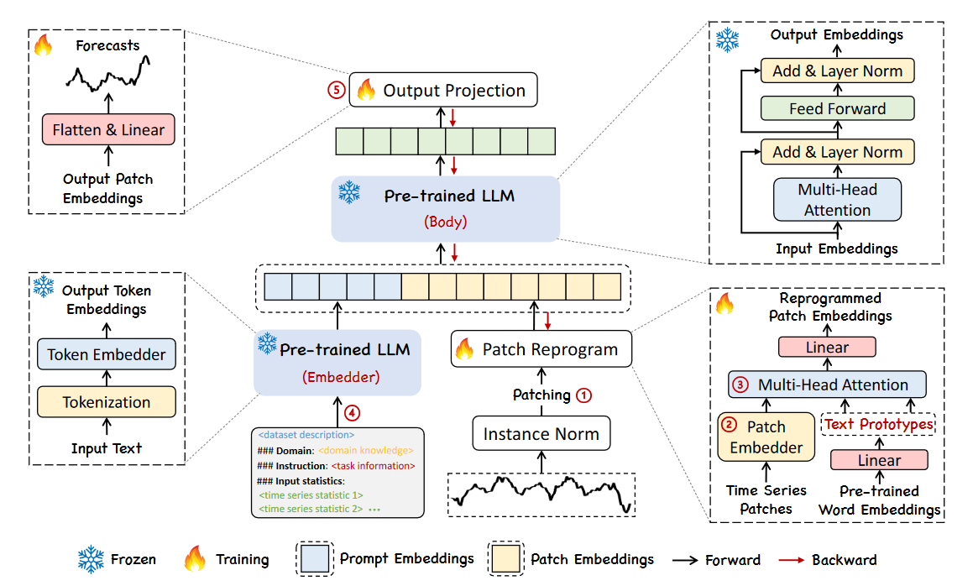
Time-LLM (based on LLaMA)
ICLR 2024

Slide 44


LLaMA – 3 Changes
SwiGLU
Pre-normalization [GPT3]
SwiGLU activation function [PaLM]
Rotary Embeddings [GPTNeo]
RMSNorm
RMSNorm
Rotary Embedding
RMSNorm

Slide 45


Time-LLM

Slide 46

UniTime (based on GPT-2)
WWW 2024

Slide 47
Evaluation

Slide 48

Metrics

Slide 49

Datasets

Slide 50
Thanks!

